Slide 1

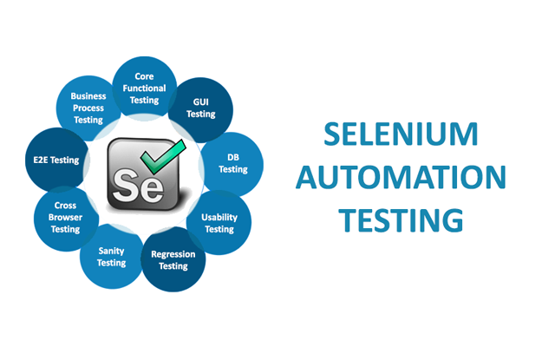
Python (Part-1)
10.Aug.2023

Slide 2
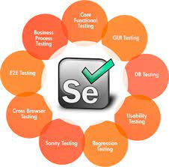
Index
Introduction
Why python for automation testing
How to install Python
How to install Selenium
Data types in Python
Control structure
Selenium setup
Selenium automation basic
References

Slide 3
Selenium introduction
"Selenium" provides a suite of tools and libraries that enable developers and testers to automate browser actions, interact with web elements, and perform functional testing on web applications with support for Java, Python, C#, and more.
Web Testing: Selenium is commonly used for automating functional and regression testing of web applications.
Cross-Browser Testing: Selenium supports multiple web browsers, including Chrome, Firefox, Safari, Edge, and more.
Automation of Repetitive Tasks: Selenium can automate repetitive tasks such as form submissions, data extraction, and content validation.

Slide 4

Why python for automation testing
Ease of Learning and Readability: Python's clean and readable syntax makes it easy for beginners to learn and write code.
Python has a rich ecosystem of libraries and frameworks that can complement Selenium automation.
Ease of Integration: Python can easily integrate with other technologies, tools, and databases, making it suitable for end-to-end testing scenarios where different components need to interact.
Scalability: Python's ability to handle both small-scale and large-scale projects makes it suitable for test automation across different project sizes.

Slide 5

How to install Python
Go to office website
Windows: https://www.python.org/downloads/windows/
Download the latest version of Python for Windows. Make sure to choose the appropriate version (Python 3.x is recommended).
Run the Installer: - Locate the downloaded installer executable file (it should have a .exe extension) and double-click on it to run the installer.
Add Python to PATH: - On the "Customize installation" screen, ensure that the option "Add Python X.X to PATH" (where "X.X" represents the version number) is checked. This will make it easier to run Python from the Command Prompt.
Verify Installation:
python --version

Slide 6
How to install Selenium
Installing Selenium: Use Below command on PIP to install Selenium Package
pip install selenium
Or
pip3 install selenium (Python 3.x version)
This command will set up the Selenium WebDriver client library on your machine with all modules and classes.
pip install -U selenium The optional –U flag will upgrade the existing version of the installed package

Slide 7
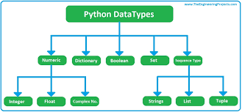
Data types in Python
Integer (int): Whole numbers without decimal points.
age = 25
Floating-Point Number (float): Numbers with decimal points.
price = 19.99
String (str): Sequence of characters enclosed in single, double, or triple quotes.
name = "Alice"
Boolean (bool): Represents either
is_student = True

Slide 8
Data types in Python
List: Ordered collection of items, mutable.
fruits = ['apple', 'banana', 'cherry']
Tuple: Ordered collection of items, immutable.
coordinates = (3, 5)
Dictionary: Collection of key-value pairs, keys are unique and immutable.
person = {'name': 'John', 'age': 30, 'city': 'New York'}
Set: Collection of unique items, unordered and mutable.
unique_numbers = {1, 2, 3, 4, 5}
Range: Represents an immutable sequence of numbers.
numbers = range(1, 6) # Represents 1, 2, 3, 4, 5

Slide 9
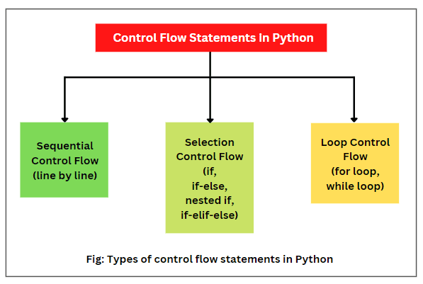
Control structure
If condition
if condition: # Code to execute if the condition is true
else: # Code to execute if the condition is false
For loop
numbers = [1, 2, 3, 4, 5]
for num in numbers:
print(num)
While loop
while condition:
# Code to be executed as long as the condition is true

Slide 10
Selenium setup
Import packages
from selenium import webdriver
from selenium.webdriver.chrome.service import Service
create a service object
service = Service()
Create a webdriver instance
driver = webdriver.Chrome(service=service)
Open a web page
driver.get('<application url>')
timer.sleep(3)

Slide 11
Selenium setup
Open a website & maximize the window
with webdriver.Chrome(service=service) as driver:
# open website using driver
driver.get("<URL>")
# maximize the browser window
driver.maximize_window()
# print the title of the page
print(driver.title)
# wait for 2 seconds
time.sleep(2)

Slide 12
Selenium setup
Implicit wait & page load
# implement implicit wait
driver.implicitly_wait(20)
# implement page load timeout
driver.set_page_load_timeout(20)
It is recommended to locate web elements using ID where ever possible instead of using relative XPATH.
This will avoid any impact of a UI design change with selenium scripts.

Slide 13
Selenium automation basic
Find the element by name
# enter user name & password
username_input = driver.find_element(By.NAME, 'username')
username_input.send_keys('<user-name>')
# enter password
password_input = driver.find_element(By.NAME, 'password')
password_input.send_keys('<password>')
click on login button
login_button = driver.find_element(By.XPATH, '//button[text()="Log In"]')
login_button.click()
click on left navigation menu
public_online_booking = driver.find_element(By.XPATH, '//span[text()="<label>"]')
public_online_booking.click()

Slide 14
Selenium automation basic
Enter a text into a text field
search_by_dropdown = driver.find_element(By.XPATH, "//input[@placeholder='Search by Code']")
# enter text in dynamic dropdown 'PUB100' & select 'PUB100003'
search_by_dropdown.click()
search_by_dropdown.send_keys('PUB100')
Select a dropdown item
religion_dropdown = driver.find_element(By.XPATH, "//select[@name='religion']")
# Create a Select object to work with the select element
select_religion = Select(religion_dropdown)
# Select an option by its text (e.g., "HINDU")
select_religion.select_by_visible_text('HINDU')

Slide 15
Selenium automation basic
Select a calendar
date_of_birth = driver.find_element(By.XPATH, "//input[@id='maxDOB']")
date_of_birth.send_keys('01/01/1980')
Select item from a dynamic dropdown
country_input = driver.find_element(By.ID, "country")
country_input.send_keys("ind")
Explicit wait for data loading
wait = WebDriverWait(driver, 10)
wait.until(EC.presence_of_element_located((By.LINK_TEXT, "India")))
# click on <a xpath="1">India</a>
driver.find_element(By.LINK_TEXT, "India").click()

Slide 16
Selenium automation basic
Using CSS_SELECTOR – syntax "<element>.<class-name>"
driver.find_element(By.CSS_SELECTOR,'li.o_m2o_dropdown_option').click()
driver.find_element(By.CSS_SELECTOR, "input.btn.btn-success.btn-lg").click()
Locate an element with matching label
cart_items = driver.find_element(By.XPATH, "//a[contains(text(), 'Checkout')]")

Slide 17
References
What is selenium: http://surl.li/kcxzt
Selenium with Python: http://surl.li/kcyab
Python tutorials: http://surl.li/kcyak
Selenium with Python full tutorial: https://youtu.be/2DD-ynCIZ4w

Slide 18


